Slide 1

ENPM 661: Planning for Autonomous Robots
Reza Monfaredi, PhD
Assistant Professor,
George Washington University
Children’s National Medical Center
Spring 2023
rmonfare@umd.edu
Notes:
<number>

Slide 2
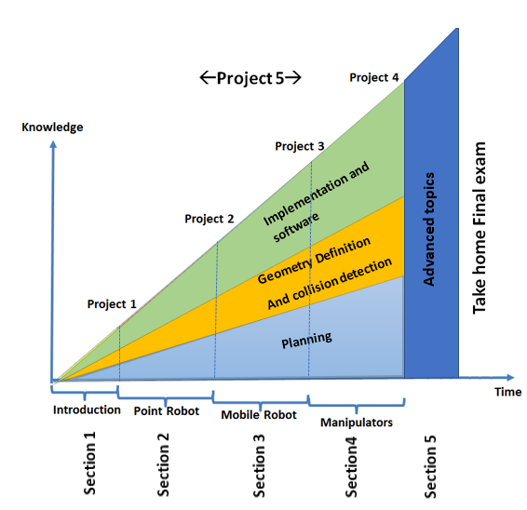
<number>

Slide 3
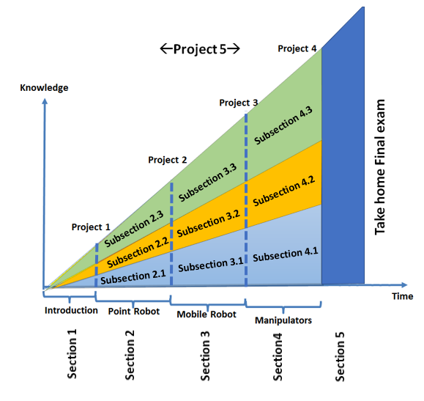
Introduction
Basic
Intermediate
Upper Int.
Advance
<number>

Slide 4
Path planning Basics (Sub-S2.1)

Slide 5
Planning (check list)
Step 1: Formulate the planning problem
Define a graph
Define edges and vertices
…
Step 2: Select an appropriate search strategy
Step 3: Generate the graph
Step 4: Search the graph
Select a search method
Define a cost function
Step 5: Back track to find the path
Note: generate and search the graph simultaneously
<number>

Slide 6
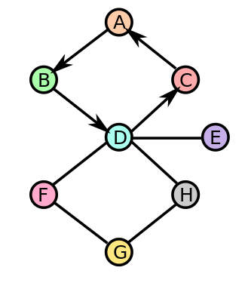
Step 1: Formulate the planning problem
State
Initial State
Goal State
Action (define actions set)
Criteria
Cost
<number>

Slide 7
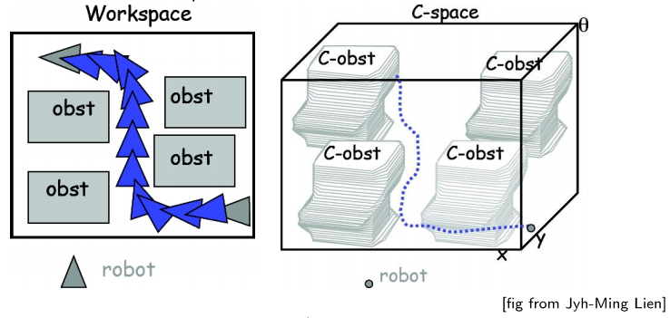
Workspaces vs. Configuration space
Planning happens in the configuration space
We use graph to represent the configuration space
<number>

Slide 8
Using graphs to represent the configuration space
Graphs are a theoretical tool that represent the configuration space.
Edges represent trajectories.
Nodes represent configurations.
Michael Otte
Notes:
<number>

Slide 9
Planning (check list)
Step 1: Formulate the planning problem
Define a graph
Define edges and vertices
…
Step 2: Select an appropriate search strategy
Step 3: Generate the graph
Step 4: Search the graph
Select a search method
Define a cost function
Step 5: Back track to find the path
Note: generate and search the graph simultaneously
<number>

Slide 10

Search Strategies vs Search Algorithms
Search Strategy
Search Algorithms
Control Method
<number>

Slide 11
Bidirectional search
Forward search
Backward search
Multi directional
Select one

Slide 12

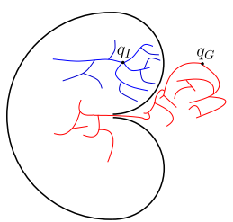
General Strategies for State Space Search
Forward search
From initial state to goal state
Backward search
From a goal state to initial state
Bidirectional search
Concurrently from the initial and goal states
$X$
$x_{I}$
$x_{G}$
(Adapted from: LaValle, S. M. Planning Algorithms, 2006)
Slide by S.K. Gupta
Notes:
<number>

Slide 13
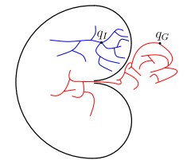
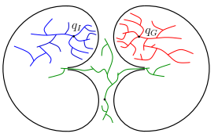
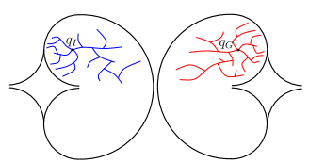
Bidirectional and Multi-directional search strategies
Bidirectional search
Multi- directional search
(Source: LaValle, S. M. Planning Algorithms, 2006)
Notes:
<number>

Slide 14
Planning (check list)
Step 1: Formulate the planning problem
Define a graph
Define edges and vertices
…
Step 2: Select an appropriate search strategy
Step 3: Generate the graph
Step 4: Search the graph
Select a search method
Define a cost function
Step 5: Back track to find the path
Note: generate and search the graph simultaneously
<number>

Slide 15
Generate the tree/graph
Systematic methods
Probabilistic methods
Actions based planning
PRM
RRT /RRT*
Systematic Roadmap
RRT with non-holonomic
Dynamic RRT

Slide 16
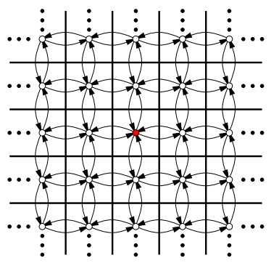
Step 2: Generate the graph
Incremental search and construction of the state space
Do not construct the complete planning space in advance! Rather, reveal it incrementally during the search.
(Source: LaValle, S. M. Planning Algorithms, 2006)
Slide by S.K. Gupta
Notes:
<number>

Slide 17
Workspace connectivity
Discrete space
4-connected 4 actions
8-connected 8 actions
16-connected 16 actions
…
Continues space
Planning cost increases
Slide by S.K. Gupta
Notes:
<number>

Slide 18
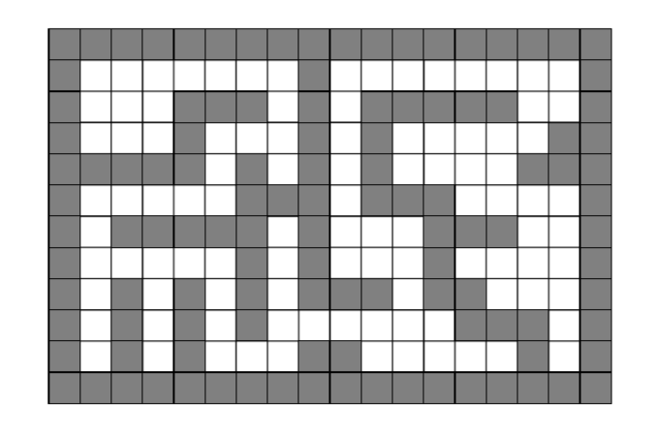
How to define action set?
Example: 4-connected space
18 × 12
State transition graph
(Source: LaValle, S. M. Planning Algorithms, 2006)
<number>
Notes:
<number>

Slide 19
4-connected space
State transition graph
<number>

Slide 20
8-connected space
State transition graph
<number>

Slide 21
Planning (check list)
Step 1: Formulate the planning problem
Define a graph
Define edges and vertices
…
Step 2: Select an appropriate search strategy
Step 3: Generate the graph
Step 4: Search the graph
Select a search method
Define a cost function
Step 5: Back track to find the path
Note: generate and search the graph simultaneously
<number>

Slide 22
Search Strategy
Search Algorithms
Control Method
<number>

Slide 23
Search the tree to find a feasible or optimal path
Brute force search
Systematic search
Non-systematic Search
Best first search
A*
Breadth first search
Dijkstra
Depth first search
Iterative deepening
D*
ARA*
The red blocks will be covered in the basic path planning section
Notes:
<number>

Slide 24
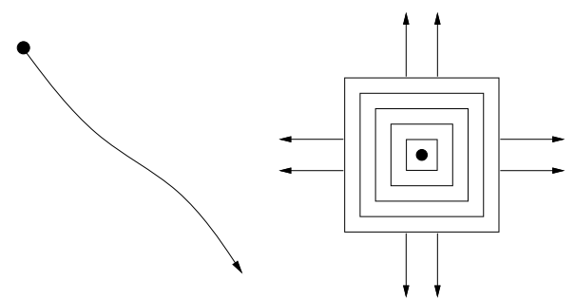
Non-systematic
Systematic search
<number>

Slide 25
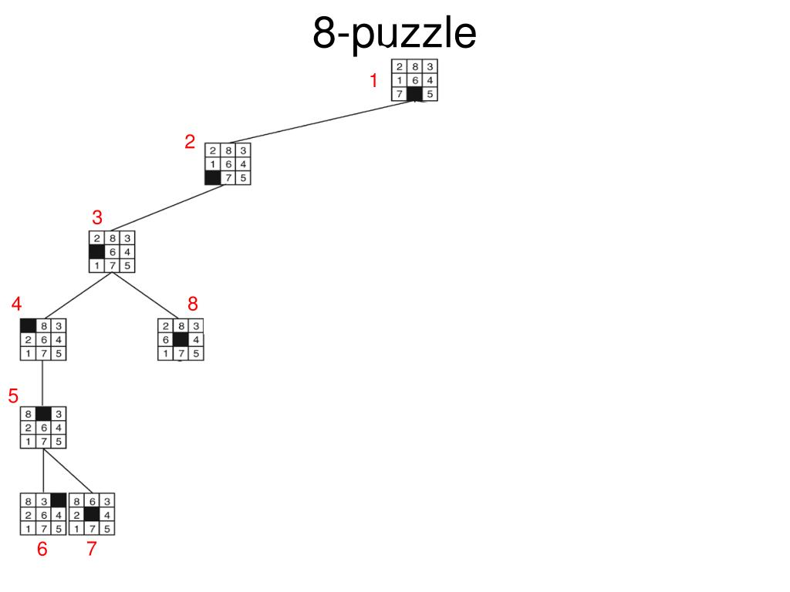
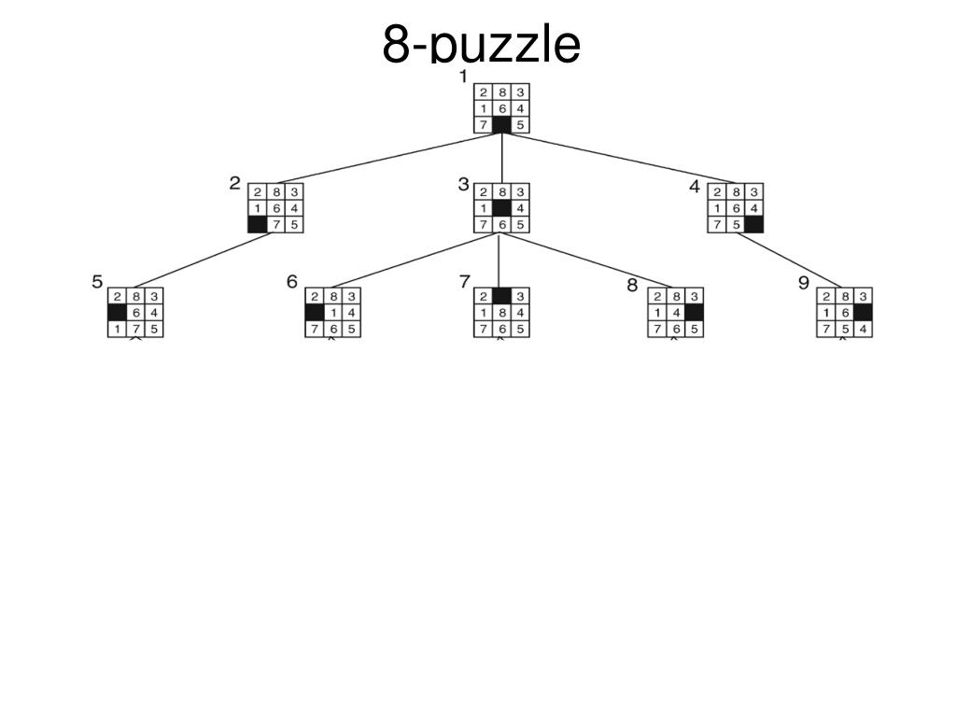
Non-systematic
Systematic search
<number>

Slide 26
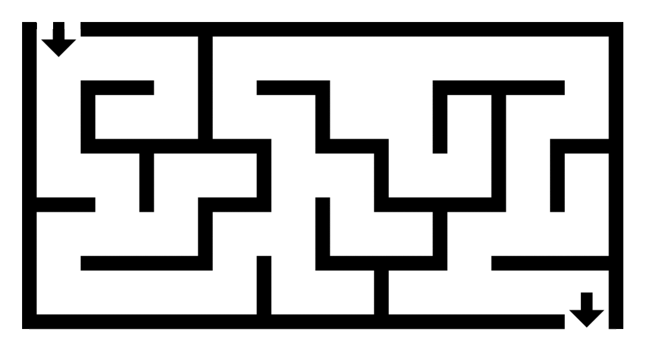
Question
https://brilliant.org/wiki/depth-first-search-dfs/
<number>

Slide 27
Systematic Search Algorithms
Search systematically
Allows to correctly declare in finite time whether or not a solution exists
The requirement to be systematic is that, in the limit, as the number of iterations tends to infinity, all reachable vertices are reached
To be systematic, the algorithm should keep track of states already visited; otherwise, the search may run forever by cycling through the same states.
Search frontier
(Source: LaValle, S. M. Planning Algorithms, 2006)
<number>
Slide by S.K. Gupta
Notes:
<number>

Slide 28
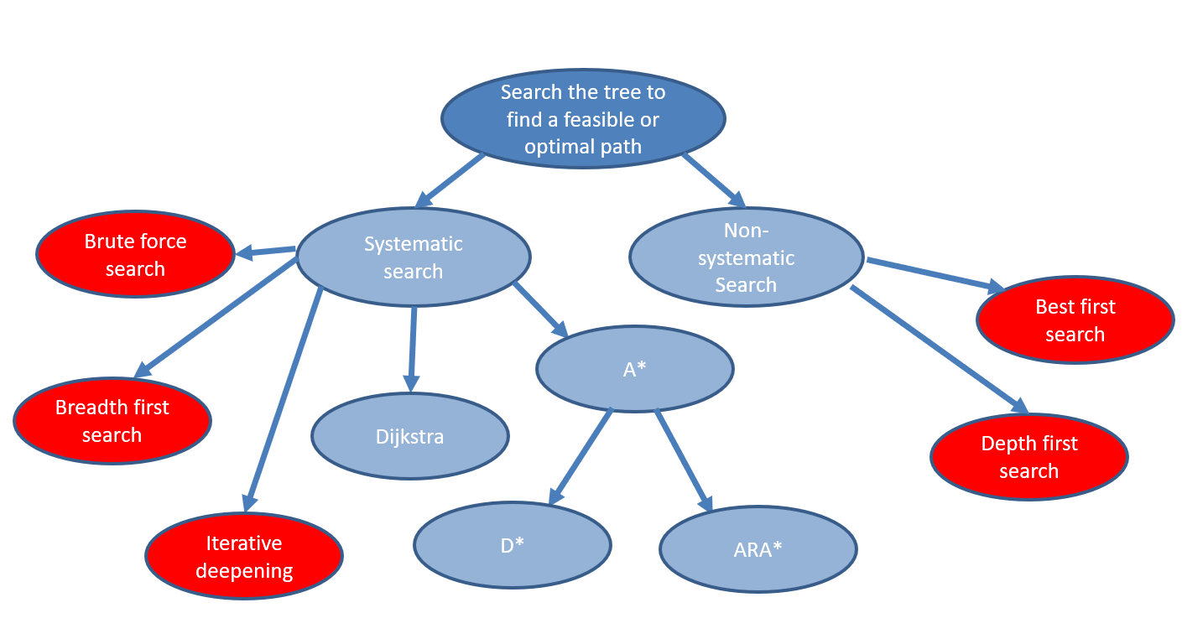
Basic Graph Search Algorithms
1) Best-First Search (Greedy algorithm)
2) Brute-force Search (Exhaustive search)
3) Breadth-First Search (pop nodes from open list in FIFO manner)
Queue (FIFO) as subroutine
4) Depth First Search (pop nodes from open list in LIFO manner)
Stack (LIFO) as subroutine
5) Iterative deepening
Notes:
<number>

Slide 29
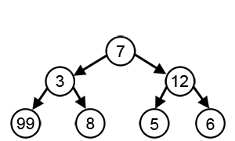
1) Best-First Search (Greedy algorithm)
Greedy algorithms focus on making the best local choice at each decision point.
Wikipedia.com
<number>

Slide 30
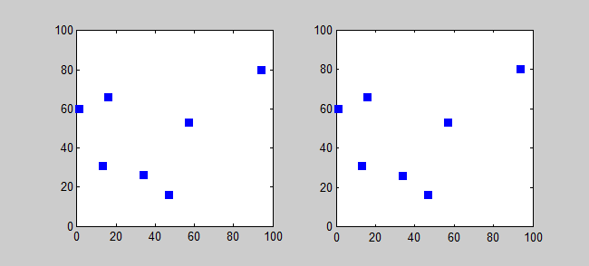
2) Brute-force Search (Exhaustive search)
https://commons.wikimedia.org/wiki/File:Bruteforce.gif
<number>

Slide 31
Brute-force approach- computation time
Brute-force approach would take running time
Need to enumerate all possible plans of length
$x_{1}$
$x_{2}$
$x_{3}$
$x_{5}$
$x_{6}$
$x_{4}$
$x_{7}$
$U∨2$
$\left(x_{1},x_{2},x_{4}\right)$
Slide by S.K. Gupta

Slide 32

3) Breadth-First Search (BFS)
Q is a FIFO-Queue
The search tree (of parent pointers) goes as wide as possible before going deeper.
Example on board ….
<number>
Notes:
<number>

Slide 33
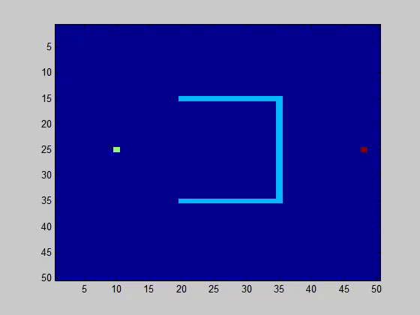
Breadth First Search (BFS): ANIMATION
(Courtesy: Petr Svec)
Slide by S.K. Gupta
<number>
Notes:
<number>

Slide 34
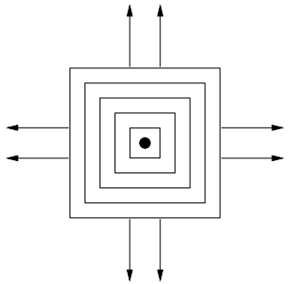
Breadth First Search (BFS)- Computation time
Search in tiers/wavefronts
Systematic search that leads to completeness if graph is finite
Optimal if all costs are the same; otherwise not!
Selects states according to First-In First-Out (FIFO) queue
Asymptotic running time
Assuming constant time in determining whether a state has been visited
if the same action set available from each state
(Source: LaValle, S. M. Planning Algorithms, 2006)
=
<number>
Slide by S.K. Gupta
Notes:
<number>

Slide 35
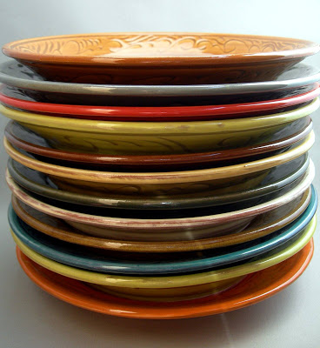
4) Depth-First Search (DFS)
Q is a Stack (LIFO-Queue)
The search tree (of parent pointers) goes as deep as possible.
Example on board….
<number>
Notes:
<number>

Slide 36
https://brilliant.org/wiki/depth-first-search-dfs/
<number>

Slide 37
Depth First Search (DFS): ANIMATION
(Courtesy: Petr Svec)
<number>
Slide by S.K. Gupta
Notes:
<number>

Slide 38
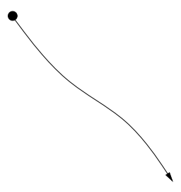
Depth First Search (DFS)- Computation time
Search for longer plans early
Systematic search in finite graphs; but not for infinite graphs!
Not optimal
Selects states according to Last-In First-Out (LIFO) queue
Asymptotic running time
Assuming constant time in determining whether a state has been visited
if the same action set available from each state
(Source: LaValle, S. M. Planning Algorithms, 2006)
Slide by S.K. Gupta
<number>
Notes:
<number>

Slide 39
5) Iterative Deepening
Preferable if the tree has large branching factor /many actions per state
Converts DFS into systematic search
Not always needed to expand all nodes down to layer of the graph before reaching goal that is steps from
1
Set
Employ DFS to find all states within distance from
If goal not found, “discard” previous work, set and go to Step 2
<number>
Slide by S.K. Gupta
Notes:
<number>

Slide 40
Iterative Deepening: ANIMATION
max. depth=10
max. depth=25
max. depth=50
(Courtesy: Petr Svec)
<number>
Slide by S.K. Gupta
Notes:
<number>

Slide 41
Planning (check list)
Step 1: Formulate the planning problem
Define a graph
Define edges and vertices
…
Step 2: Select an appropriate search strategy
Step 3: Generate the graph
Step 4: Search the graph
Select a search method
Define a cost function
Step 5: Back track to find the path
Note: generate and search the graph simultaneously
<number>

Slide 42
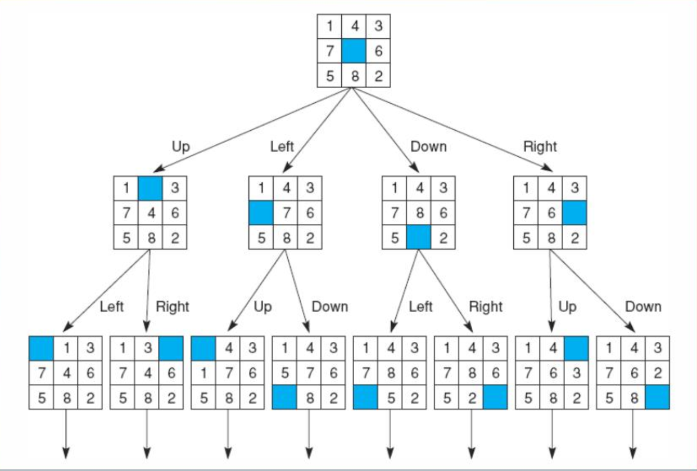
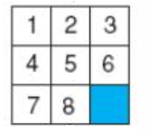

Initial State
Obstacle?
Plan
Initial State?
Goal State?
States
State?
Action?
Actions
Plan?
Looking for the parent node
Goal State
<number>
Notes:
<number>

Slide 43
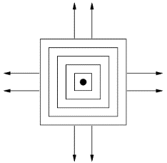
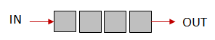


We need data structure to store and search the nodes
Search algorithms mostly differ on the sorting method of
Breadth First Search (BFS)
Search in tiers/wavefronts
sorted as First-In First-Out (FIFO)
Depth First Search (DFS)
Search for longer plans early
sorted as Last-In First-Out (LIFO)
Iterative deepening
Repeated DFS with increasingly greater depths
(Source: LaValle, S. M. Planning Algorithms, 2006)
Slide by S.K. Gupta
<number>
Notes:
<number>

Slide 44
Project 1
<number>

Slide 45
End of Sub-S2.1

Slide 46
<number>

Slide 47
Geometry definition and collision detection Basics (Sub-S2.2)

Slide 48
How to represent the C-space?
<number>

Slide 49
Method 1) Define the map using a 2D matrix
<number>

Slide 50
Question
https://brilliant.org/wiki/depth-first-search-dfs/
<number>

Slide 51
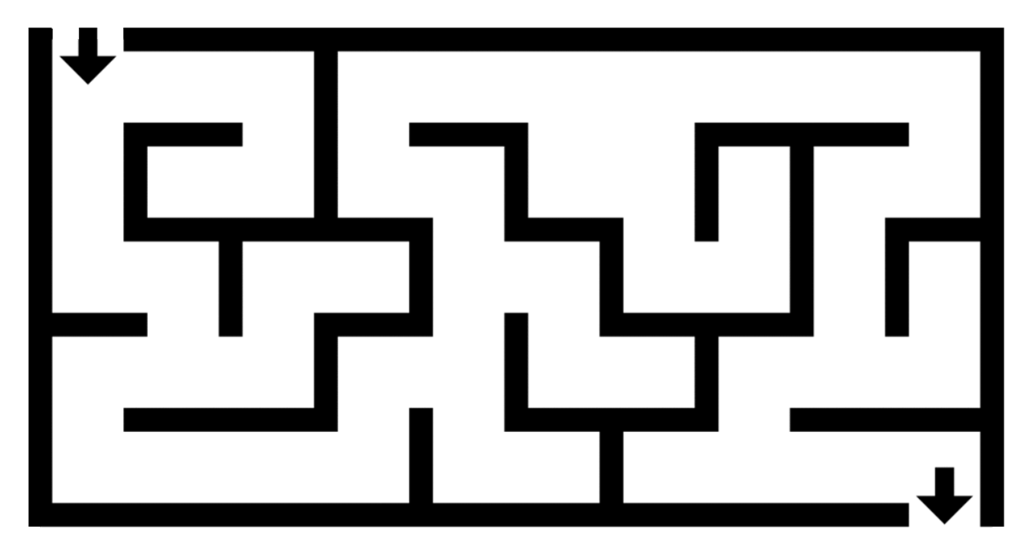
Workspace
<number>

Slide 52
Workspace
<number>

Slide 53
<number>

Slide 54
Advantages
Can represent complicated maps
Disadvantages
Resolution dependent
Dynamic obstacles
<number>

Slide 55
Method 2) Use Polygonal Models and Semi-Algebraic Models
<number>

Slide 56

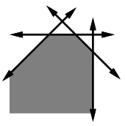
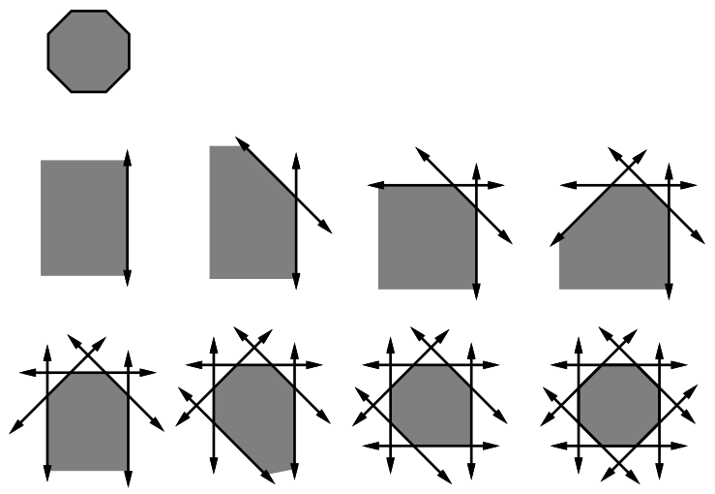
Polygonal Models
Solid representation of convex polygon as Boolean combination of half-plane primitives
${O=H}_{1}∩H_{2}∩…∩H_{m}$
-
-
+
+
+
-
-
-
+
+
+
+
+
-
-
-
-
+
+
+
+
+
$f_{i}\left(x,y\right)<0$
+
$f_{i}\left(x,y\right)>0$
-
-
-
+
+
+
$H_{1}$
$H_{1}∩H_{2}$
$H_{1}∩H_{2}$
-
-
-
-
+
+
-
-
-
-
-
+
+
+
+
+
$f_{i}\left(x,y\right)=ax+by+c=0$
(Adapted from: LaValle, S. M. Planning Algorithms, 2006)
slide by S. K. Gupta
<number>
Notes:
<number>

Slide 57
Polygonal Models (Cont.)
Solid representation of non-convex polygon as union of convex polygons
$O_{2}$
$O_{3}$
$O_{4}$
$O_{1}$
$O_{4}$
$O_{5}$
$O_{6}$
slide by S. K. Gupta
<number>
Notes:
<number>

Slide 58
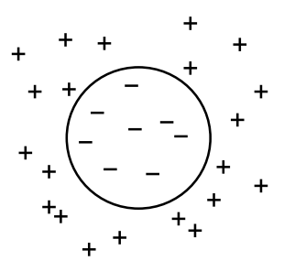

Semi-Algebraic Models
Solid representation of semi-algebraic set as Boolean combination of algebraic primitives
Algebraic primitive defined by a polynomial primitive
$f_{1}\left(x,y\right)≤x^{2}+y^{2}−r_{1}^{2}$
$f\left(x,y\right)=x^{2}+y^{2}−4$
${O=H}_{1}∩H_{2}∩H_{3}∩H_{4}$
(Source: LaValle, S. M. Planning Algorithms, 2006)
slide by S. K. Gupta
<number>
Notes:
<number>

Slide 59
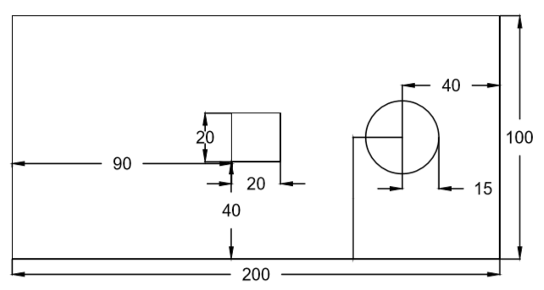
Example:
160
50
How to define obstacle: for square: point (x,y) is in the obstacle space if x>=90 and x<= 110 and y>=40 and y<=60
for circle: point (x,y) is in the obstacle space if (x-160)^2+(y-50)^2 < 15^2
Notes:
<number>

Slide 60
End of Sub-S2.2

Slide 61
Introduction
Basic
Intermediate
Upper Int.
Advance
<number>

Slide 62
Path planning Implementation and Software Basics (Sub-S2.3)

Slide 63
Graph Search: Preliminaries
UNVISITED
Node that has not been “touched” yet
OPEN (Live)
Node is on the fringe of the search tree
It is currently in the priority queue (open list)
VISITED (Closed)
Node is internal to the search tree
Node has been removed from the priority queue (explored nodes)
Notes:
<number>

Slide 64
Stack
Queue
<number>

Slide 65
Data Structures
Low-level
int, float, double, char, etc.
Mid-level
Array, vector, matrix
High level
Queue, Stack, Heap
Tree, Graph
Notes:
<number>

Slide 66
Queue
Technically a “First-In-First-Out Queue” or FIFO-Queue
Q Queue
Q.INSERT(v) adds node v to the “back”
Q.TOP() returns the node at the “front”
Q.POP() returns the node at the “front” and removes it from Q
Michael Otte
Notes:
C#:
EnQueue
DQueue
<number>

Slide 67
Queue
Technically a “First-In-First-Out Queue” or FIFO-Queue
What happens: Q.INSERT(A) Q.INSERT(A)
Q.INSERT(B) Q.POP()
Q.TOP() Q.POP()
Q.INSERT(C)
Q.POP()
Q.INSERT(D)
Q.POP()
Q.TOP()
Q.POP()
Q.INSERT(E)
Notes:
<number>

Slide 68
Stack
Technically a “Last-In-First-Out Queue” or LIFO-Queue
STK Stack (LIFO-Queue)
STK.INSERT(v) adds node v to the “top”
STK.TOP() returns the node at “top”
STK.POP() returns the node at “top” and removes it from Q
Image from “Art for daily life”
Notes:
Push
Pop
<number>

Slide 69
Stack
Technically a “Last-In-First-Out Queue” or FIFO-Queue
What happens:
STK.INSERT(A)
STK.TOP()
STK.INSERT(C)
STK.POP()
STK.INSERT(D)
STK.POP()
STK.TOP()
STK.POP()
STK.INSERT(E)
STK.INSERT(A)
STK.INSERT(B)
STK.POP()
STK.POP()
Michael Otte
Image from “Art for daily life”
Notes:
<number>

Slide 70
Priority Queue (Priority Heap)
62
62.1
100
Nodes are sorted by key values, v.KEY
Min-Priority Queue vs. Max-Priority Queue
H.INSERT(v) adds node v where it goes
H.TOP() returns node with min/max key
H.POP() returns & removes the node at “top”
H.REMOVE(v) returns & removes node v
H.UPDATE(v) updates position of v (after key change)
59
35
100
34
129
29
691
3
987
Notes:
<number>

Slide 71
Priority Queue (Priority Heap)
62
62.1
100
Assume max-priority queue:
A.KEY = 5; H.INSERT(A);
B.KEY = 3; H.INSERT(B);
C.KEY = 10; H.INSERT(C);
B.KEY = 7; H.UPDATE(B);
H.TOP();
A.KEY = 12; H.UPDATE(A);
59
35
100
34
129
29
691
3
987
H.REMOVE(C);
H.POP();
D.KEY = 4; H.INSERT(D);
B.KEY = 2; H.UPDATE(B);
H.REMOVE(TOP());
H.POP();
Michael Otte
Notes:
<number>

Slide 72
Basic pseudo code for tree/graph search
Algorithmic notation: “←” vs. “=”
“←” assignment operator
A←B
sets the value of A to be the same as that in B
“=” boolean function that checks for equality
A=B
returns true if a and b have the same value
returns false if a and be have different values
Notes:
<number>

Slide 73
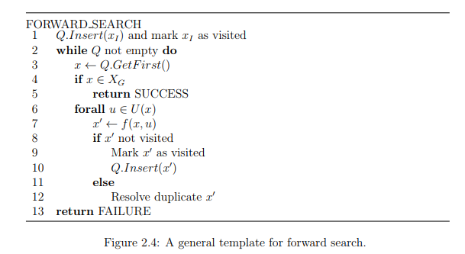
Basic pseudo code for tree/graph search
(Source: LaValle, S. M. Planning Algorithms, 2006)
<number>

Slide 74
End of Sub-S2.3

Slide 75
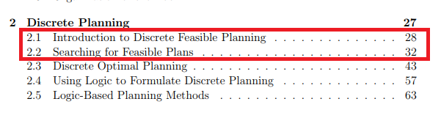

Readings
Main text:
LaValle, Steven M. Planning Algorithms. Cambridge University Press, 2006.
Available for free online: http://planning.cs.uiuc.edu/
<number>

Slide 76
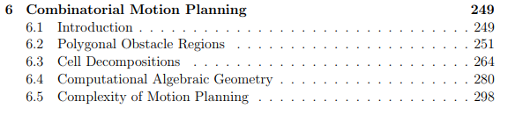
Readings
Main text:
LaValle, Steven M. Planning Algorithms. Cambridge University Press, 2006.
Available for free online: http://planning.cs.uiuc.edu/
<number>

